Slide 1
Design Solutions by using Platform Services
Mohd Mishal
Cloud Consultant
Technical Trainer | MCT

Slide 2
Design Solutions by using Platform Services (10-15%)
Design for Artificial Intelligence Services
Determine when to use the appropriate Cognitive Services, Azure Bot Service, Azure Machine Learning, and other categories that fall under cognitive AI
Design for IoT
Determine when to use Stream Analytics, IoT Hubs, Event Hubs, real-time analytics, Time Series Insights, IoT Edge, Notification Hubs, Event Grid, and other categories that fall under IoT
Design messaging solution architectures
Design a messaging architecture; determine when to use Azure Storage Queues, Azure Service Bus, Azure Event Hubs, Event Grid, Azure Relay, Azure Functions, and Azure Logic Apps; design a push notification strategy for Mobile Apps; design for performance and scale
Design for media service solutions
Define solutions using Azure Media Services, video indexer, video API, computer vision API, preview, and other media related services
Notes:
https://www.microsoft.com/en-us/learning/exam-70-535.aspx

Slide 3
Design for Artificial Intelligence Services
Cognitive Services
Bot Services
Machine Learning

Slide 4

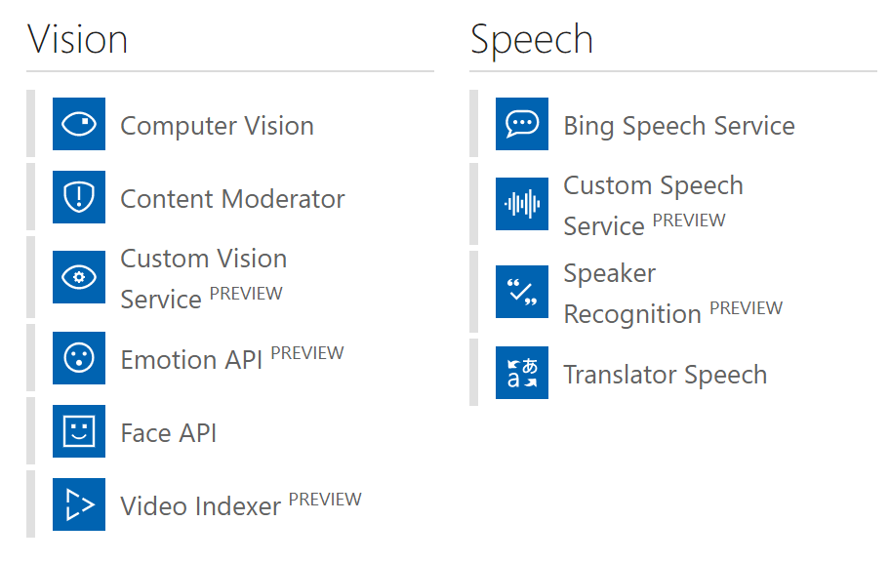
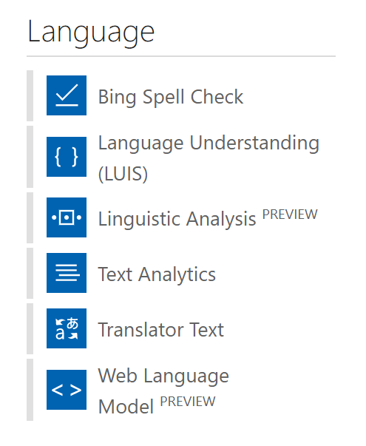
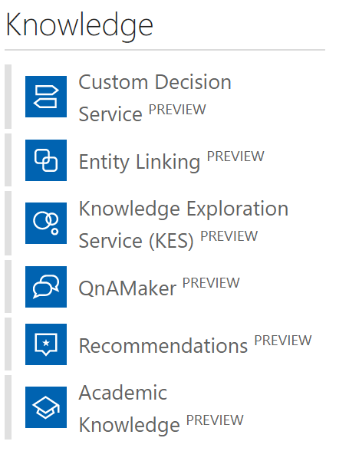
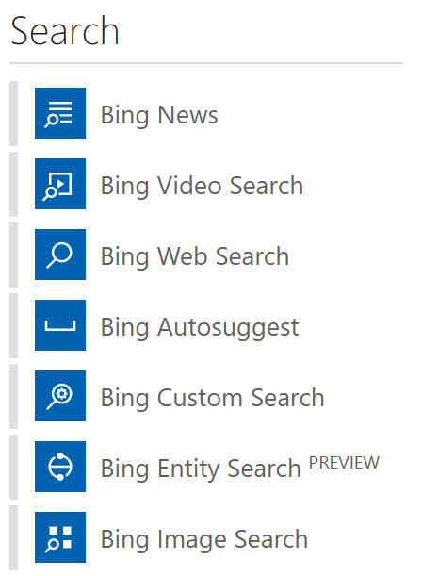
Cognitive Services
Notes:
MACHINE LEARNING FOR THOSE WHO AREN’T AI EXPERTS
CUSTOM VISION SERVICE—REAL TIME VIDEO FEEDS—WHO MIGHT BE CARRYING A WEAPON? PARTNERS IN PUBLIC SECURITY SPACE.
29 comprehensive collection of intelligent and knowledge API to build smarter APPS
Available across platform
Easy integration with your experience
No background Machine learning

Slide 5
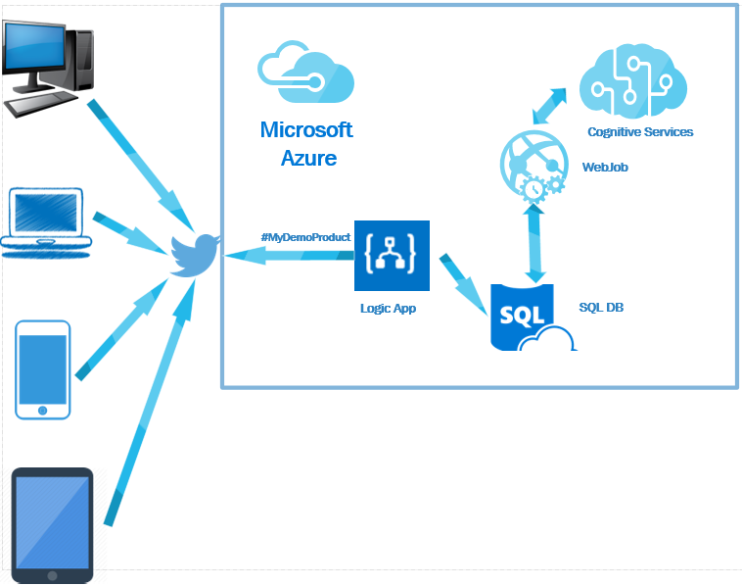
Notes:
Capture tweets from twitter or comments from Facebook and Figure out the sentiment of the tweets.
https://blogs.msdn.microsoft.com/biblog/2016/11/01/build-social-sentiment-analysis-solution-using-microsoft-azure-services/

Slide 6

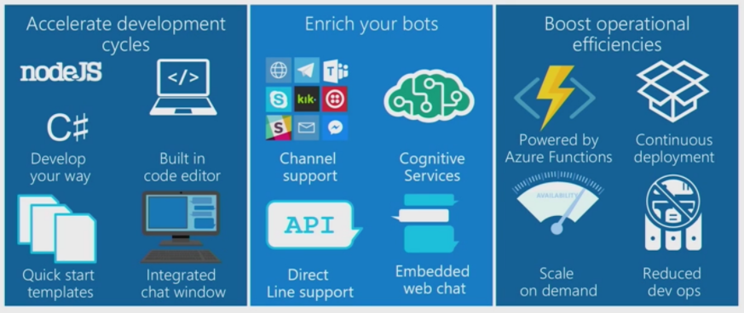
Bot Services
Notes:
Build, connect, deploy, and manage intelligent bots to interact naturally with your users on websites, apps, Cortana, Microsoft Teams, Skype, Slack, Facebook Messenger, and more. Get started quickly with a complete bot-building environment. You’ll pay only for what you use.

Slide 7
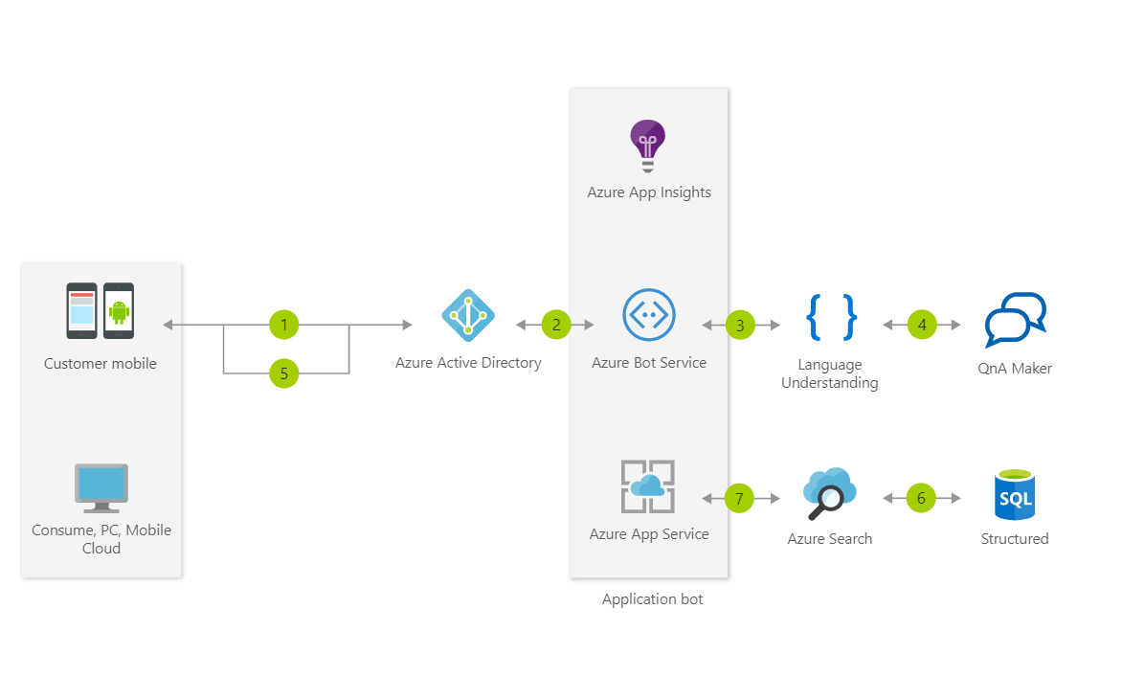
Notes:
This Informational Bot can answer questions defined in a knowledge set or FAQ using Cognitive Services QnA Maker and answer more open-ended questions using Azure Search

Slide 8

Some Modelling Techniques in Azure ML
MULTICLASS CLASSIFICATION
Predict failures with their causes within a future time period
Predict remaining useful life within ranges of future periods
REGRESSION or SURVIVAL ANALYSIS
1001001010
ANOMALY DETECTION
Predict remaining useful life, the amount of time before the next failure
Identify change in normal trends to find anomalies
BINARY CLASSIFICATION
Predict failures within a future period of time
Notes:
AZURE MACHINE LEARNING

Slide 9
Design for IoT
Stream Analytics
IoT Hubs
Time Series Insights
IoT Edge

Slide 10

Stream Analytics
Instantly analyze data from all your IoT devices and gateways
Develop massively parallel Complex Event Processing (CEP) pipelines with simplicity
Start in seconds, scale instantly, pay per job
Build real-time dashboards in minutes
Enterprise grade availability, auditing and support
Notes:
An on-demand real-time analytics service to power intelligent action
Easily develop and run massively parallel real-time analytics on multiple IoT or non-IoT streams of data using simple SQL like language. Use custom code for advanced scenarios. With no infrastructure to manage, you can process data on-demand, scale instantly, and only pay per job.
HIGH AVAILABITY, AUDITING AND SUPPORT
FIND NEEDLES IN HAYSTACKS, PULL THEM OUT AND ACT ON THEM
BIG COMPUTE INFRASTRUCTURE BEHIND IT

Slide 11

IoT Hub
Establish bi-directional communication with billions of IoT devices
Authenticate per device for security-enhanced IoT solutions
Register devices at scale with IoT Hub Device Provisioning Service
Manage your IoT devices at scale with device management
Notes:
Connect, monitor, and manage billions of IoT assets
Get started quickly
Register and provision IoT devices automatically
Connect and manage billions of IoT devices and assets
Establish reliable, bi-directional communication
Enhance the security of your IoT solutions
Ingest real-time data and upload files to the cloud
GUNSHOT—TURN LIGHTS UP—NOTIFY POLICE
ATLANTA IS A SMART CITY
7,000 CAMERAS IN ATLANTA—IoT DEVICES
USE BING / COSMOS DB
COGNITIVE APIs LOOKING FOR DISTRESSED PEOPLE

Slide 12

Time Series Insights
Find actionable insights in seconds
Start in seconds, scale in minutes
Create a global view of your IoT-scale data
Apply Time Series Insights to your apps and solutions
Access enterprise-grade security and support
Notes:
Time Series Insights
The best platform for storing and managing time-series data
Azure Time Series Insights is a fully managed analytics, storage, and visualization service for managing IoT-scale time-series data in the cloud. It provides massively scalable time-series data storage and enables you to explore and analyze billions of events streaming in from all over the world in seconds. Use Time Series Insights to store and manage terabytes of time-series data, explore and visualize billions of events simultaneously, conduct root-cause analysis, and to compare multiple sites and assets.
IMPLEMENTED WITH DOCKER CONTAINERS

Slide 13
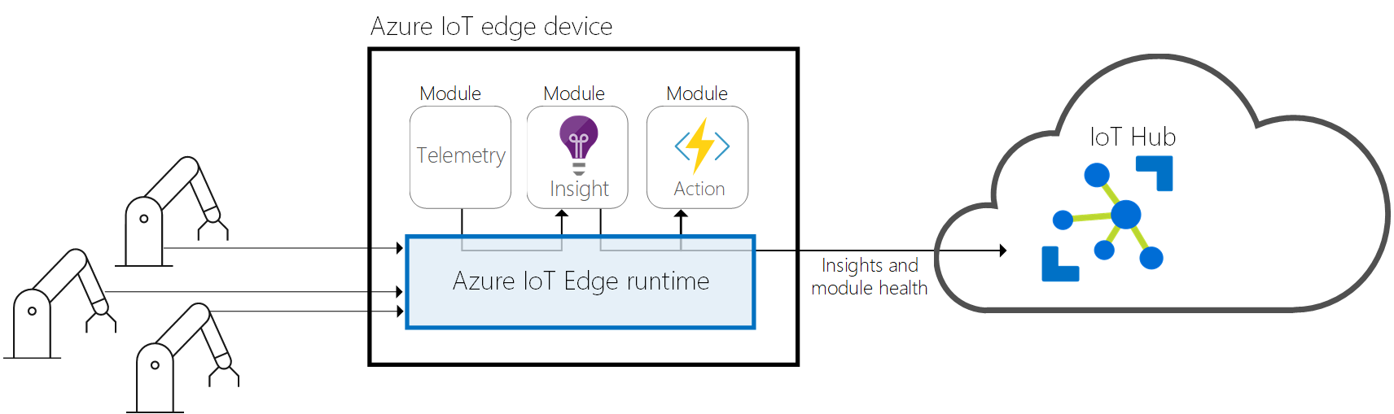
IoT Edge
Extend cloud intelligence to edge devices
Run artificial intelligence at the edge
Perform edge analytics
Deploy IoT solutions from cloud to edge
Manage devices centrally from the cloud
Operate with offline and intermittent connectivity
Enable real-time decisions
Connect new and legacy devices
Reduce bandwidth costs
Notes:
Extend cloud intelligence to edge devices
Run artificial intelligence at the edge
Perform edge analytics
Deploy IoT solutions from cloud to edge
Manage devices centrally from the cloud
Operate with offline and intermittent connectivity
Enable real-time decisions
Connect new and legacy devices
Reduce bandwidth costs

Slide 14
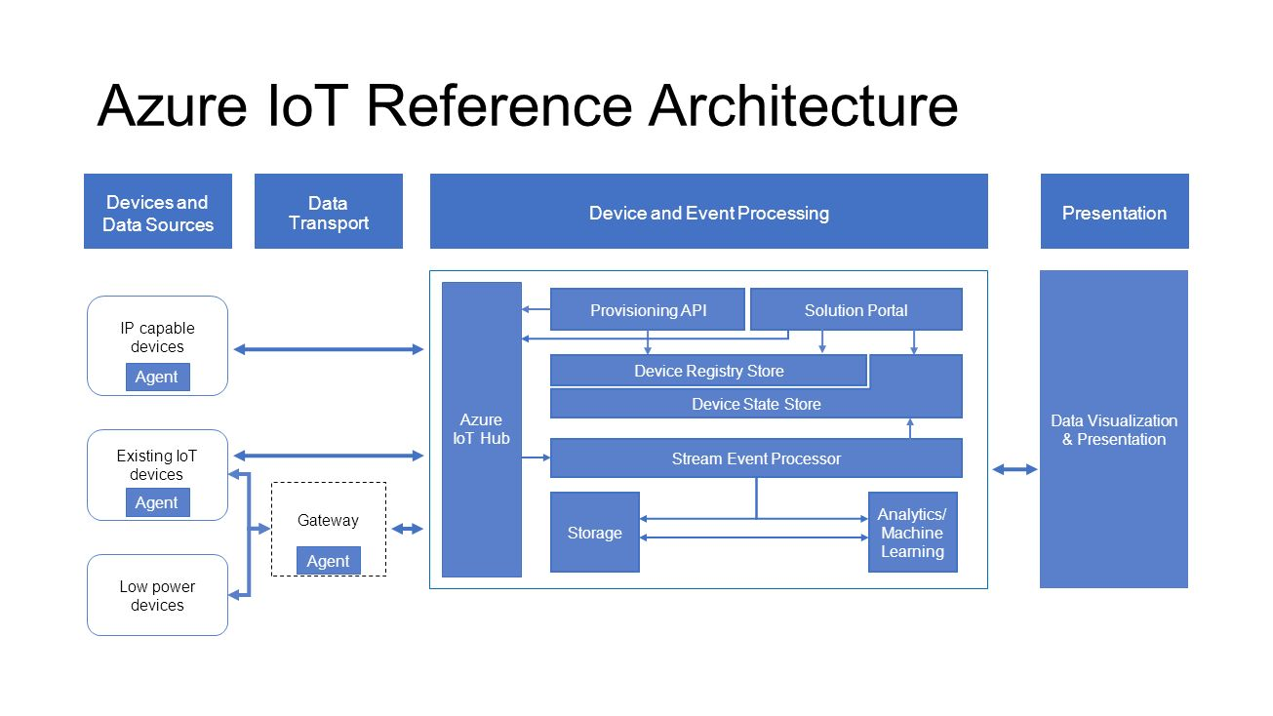
Notes:
USED TO BE CALLED LAMBDA ARCH OR KAPP ARCH

Slide 15
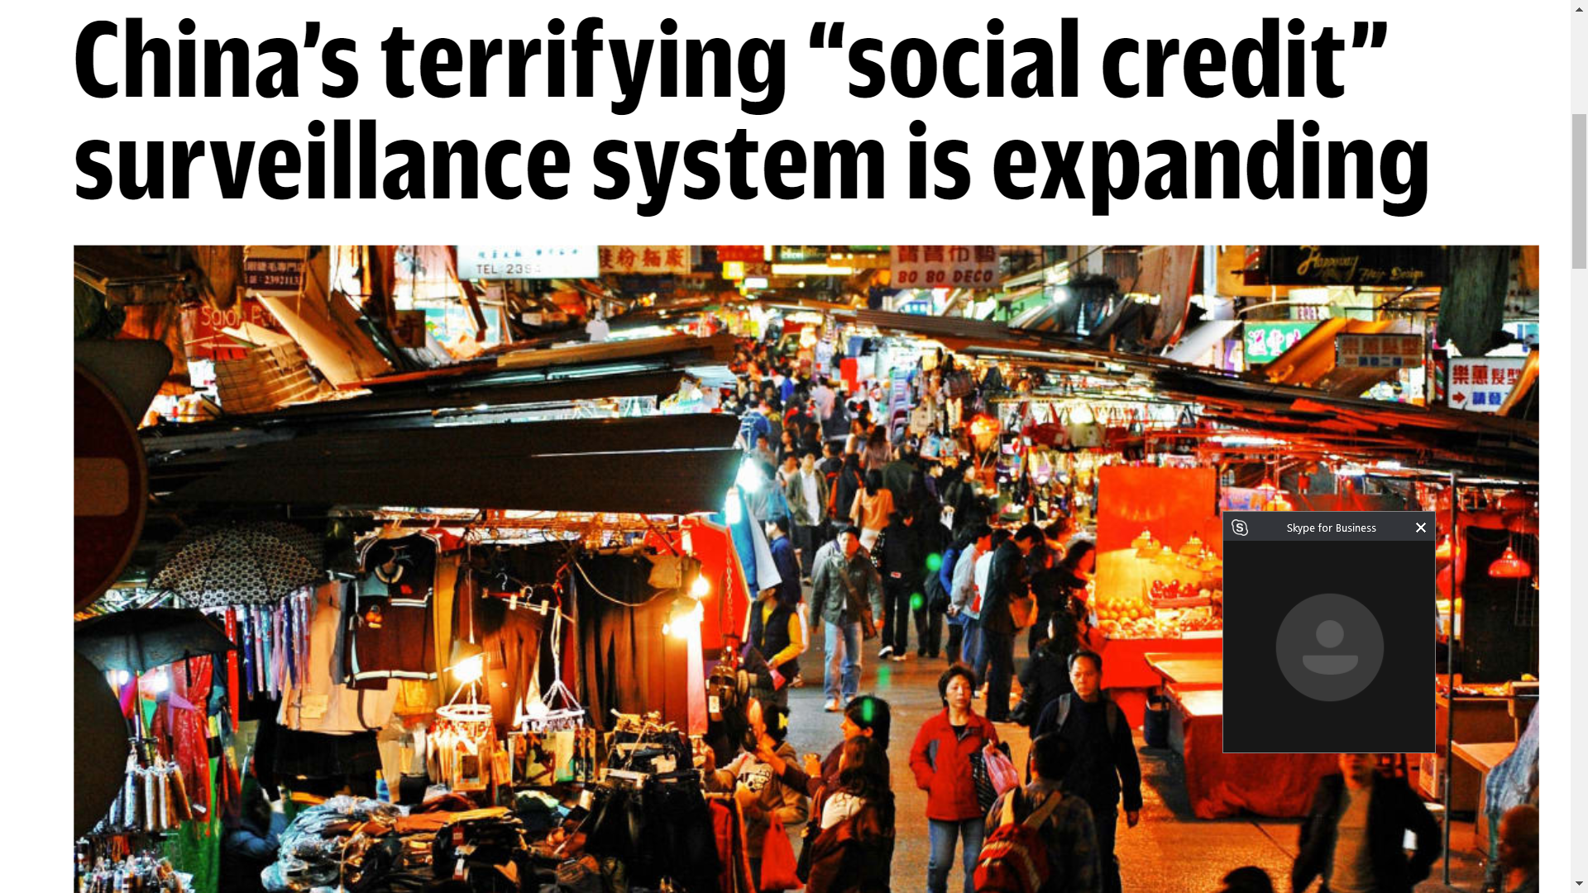
Notes:
Fast Company
Apr 24, 2018
In the Black Mirror episode “Nosedive,” writers Rashida Jones and Michael Schur created a bleak world where everyone has a public rating system based on their social media ranking. The episode features Bryce Dallas Howard as a young woman who tries to improve her respectable 4.2 score to get better flight options and other perks. Things quickly spiral out of control–as they tend to do on Black Mirror.
Whereas most viewers saw that episode as a dystopian horror story, China apparently thought it was a great idea. By 2020, the country plans to give all its 1.4. billion citizens a personal score, based on how they behave, according to CBS News. The government started working on its so-called social credit system back in 2014, which ranks citizens on their trustworthiness, including whether they jaywalk, buy Chinese-made products, what they post online, and whether they smoke in nonsmoking areas. Those deemed trustworthy can get discounts on energy bills and better interest rates at banks, while those considered untrustworthy can reportedly be stopped from buying property and even high-speed internet.
The system works a bit like credit scores, but instead of being based on good or bad financial decisions, Chinese citizens are being scored on things like whether they pay their taxes on time to how they cross the street to what they post online, per CBS. As 2020 approaches, some with low scores are already feeling the effects of a low social credit score–nearly 11 million Chinese can no longer fly and four million are barred from trains.
Next week, the program will start expanding nationwide, and more citizens will start to feel the watchful eyes of Big Brother as China’s network of surveillance cameras grows to an estimated 600 million cameras.

Slide 16
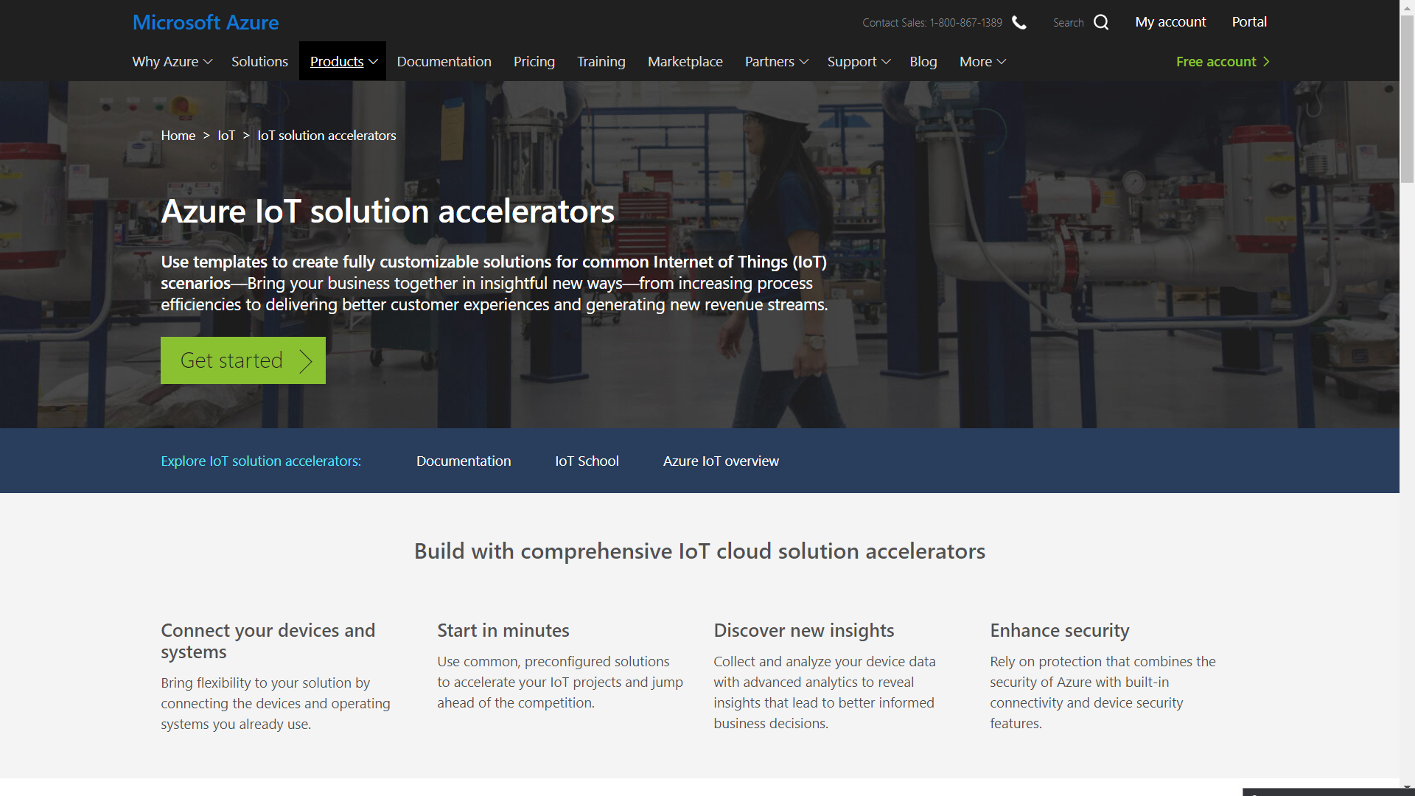

Slide 17
Messaging
Service Bus
Queues
Topics
Azure Relay
Service Bus Tiers
Azure Storage Queue

Slide 18

Service bus
PaaS with no Infrastructure management
Relay capabilities to build hybrid apps
Supports AMQP and common protocols such as HTTP
Contains Event Hub, a cloud scale telemetry ingress service.
Notes:
Service Bus is a multi-tenant cloud service
Microsoft Azure Service Bus is a reliable information delivery service. The purpose of this service is to make communication easier. When two or more parties want to exchange information, they need a communication facilitator.
AMQP Advanced Message Queuing Protocol -- BIG IN IOT SPACE

Slide 19
Service Bus Topic
S
R
Subs
Topic
S
R
R
R
S
R
One to many broadcasting scenarios
Filter messages
Use ReceiveBatch() or ReceiveBatchAsync() to receive a batch of messages
Notes:
RECEIVERS SUBSCRIBE TO A TOPIC, SO MULTIPLE READERS COULD RECEIVE THE SAME MESSAGE
IF A SUBSCRIPTION HAS MULTIPLE READERS, (E.G. MIDDLE RECEIVER ON THE SLIDE) ONLY ONE OF THE READERS WOULD GET THAT MESSAGE

Slide 20
Service Bus Queue
S
R
S
Queue
R
S
R
Point to point communication
FIFO order guarantee
Supports Batch Receive and Batch Send
Notes:
A MESSAGE GETS SENT TO ONE RECEIVER ONLY
LOAD LEVELLING—HIGH VOLUME INTO ONE STREAM
EXAM: GROUPING RELATED MESSAGES INTO A SESSION
AMQP—GROUP

Slide 21
Event Hub
Ingest messages at scale at high throughput, high volume and low latency
Typical use cases are IOT and enterprise logging
Messages are durable for 7 days
No enterprise messaging features such as dead letter queue
Notes:
Azure Event Hubs is a highly scalable data streaming platform and event ingestion service, capable of receiving and processing millions of events per second. Event Hubs can process and store events, data, or telemetry produced by distributed software and devices. Data sent to an event hub can be transformed and stored using any real-time analytics provider or batching/storage adapters
LARGE VOLUME WITH LOW LATENCY
DATA MUST BE OFFLOADED SOMEWHERE IF YOU CAN’T ACCESS IT WITHIN SEVEN DAYS

Slide 22
Connectivity for Hybrid Applications
Azure Relay
Hybrid connections and WCF Relay are part of the Azure Relay service
Communicate with on-premises resources without opening a firewall port
Hybrid Connections support multi-platform scenarios.
Hybrid Connections can be used to connect to any TCP port including SQL DB’s and Web API’s.
WCF Relay can communicate with WCF services and .NET Framework only.
VPN
Connect an Azure Web App to on-premises via VPN.
VNET integration gives a multi tenant Web App Access to resources accessible by an Azure VNET.
App Service Environment (ASE) can be deployed into an Azure VNET for bidirectional access.
Notes:
The Azure Relay service facilitates hybrid applications by enabling you to securely expose services that reside within a corporate enterprise network to the public cloud, without having to open a firewall connection, or require intrusive changes to a corporate network infrastructure. Relay supports a variety of different transport protocols and web services standards.
Windows Communication Foundation
EXAM:EXPRESSROUTE IS PRIVATE CONNECTION.
OFTEN ORGS USE VPN AS WELL—FASTER TO SET UP, CAN FAIL OVER FROM EXPRESSROUTE TO VPN
EXAM: WCF RELAY-.NET FRAMEWORK, OTHERWISE, EXPRESSROUTE OR ?
RRAS CAN BE A VPN ENDPOINT TO GO TO AZURE
DATACENTER TO DATACENTER—CAN USE VPN
POINT TO SITE=TO DISCRETE PARTS OF AZURE

Slide 23
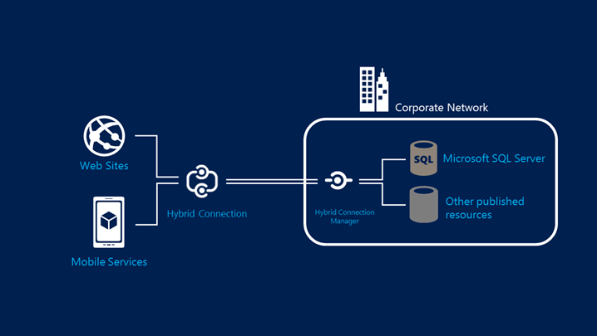
Hybrid Connections Architecture
Notes:
ORIGINATED BY A MICROSOFT ENGINEER IN REDMOND WHO WANTED TO CONNECT TO HIS DAD’S HOUSE IN GERMANY TO ACCESS RECORDED SOCCER GAMES!
NO FIREWALL PORTS NEED TO BE OPENED BUT YOU NEED AGENTS RUNNING AS A SERVICE
HYBRID CONNECTIONS CONNECT TO APP SERVICES, INCLUDING FUNCTIONS, MOBILE APIS
HYBRID CONNECTIONS ARE REALLY SERVICE BUS RELAYS UNDER THE HOOD

Slide 24
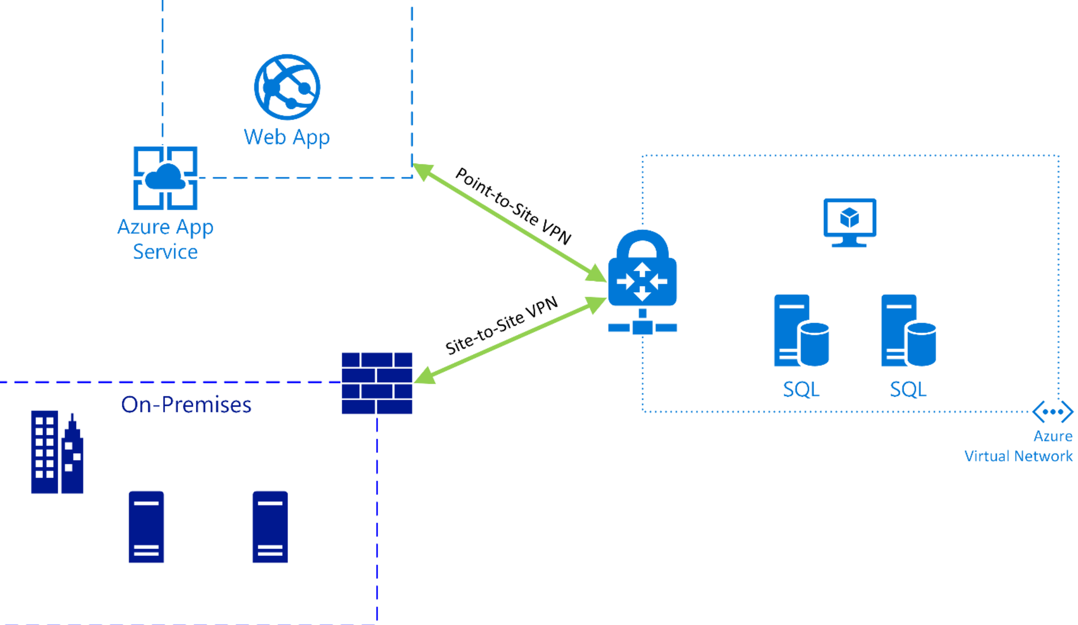
Azure Web App VNET Integration
Notes:
THIS IS WHERE MOST COMPANIES START, I.E. THE LOW HANGING FRUIT
CONTROL WHO HAS ACCESS TO WHAT AND WHAT DATA IS FLOWING WHERE
THINK OF CLOUD AS EXTENSION OF ON-PREMISE NETWORK

Slide 25
Question: Your app needs a brokered messaging channel to an on premises line of business application that offers a WCF endpoint to clients. You need to implement connectivity without changing on-premises firewall rules. Implementation needs to have a lower cost compared to other options. Choose an implementation below.
Express Route
Site to Site VPN
Hybrid Connection
WCF Relay
Express Route
Site to Site VPN
Hybrid Connection
WCF Relay

Slide 26
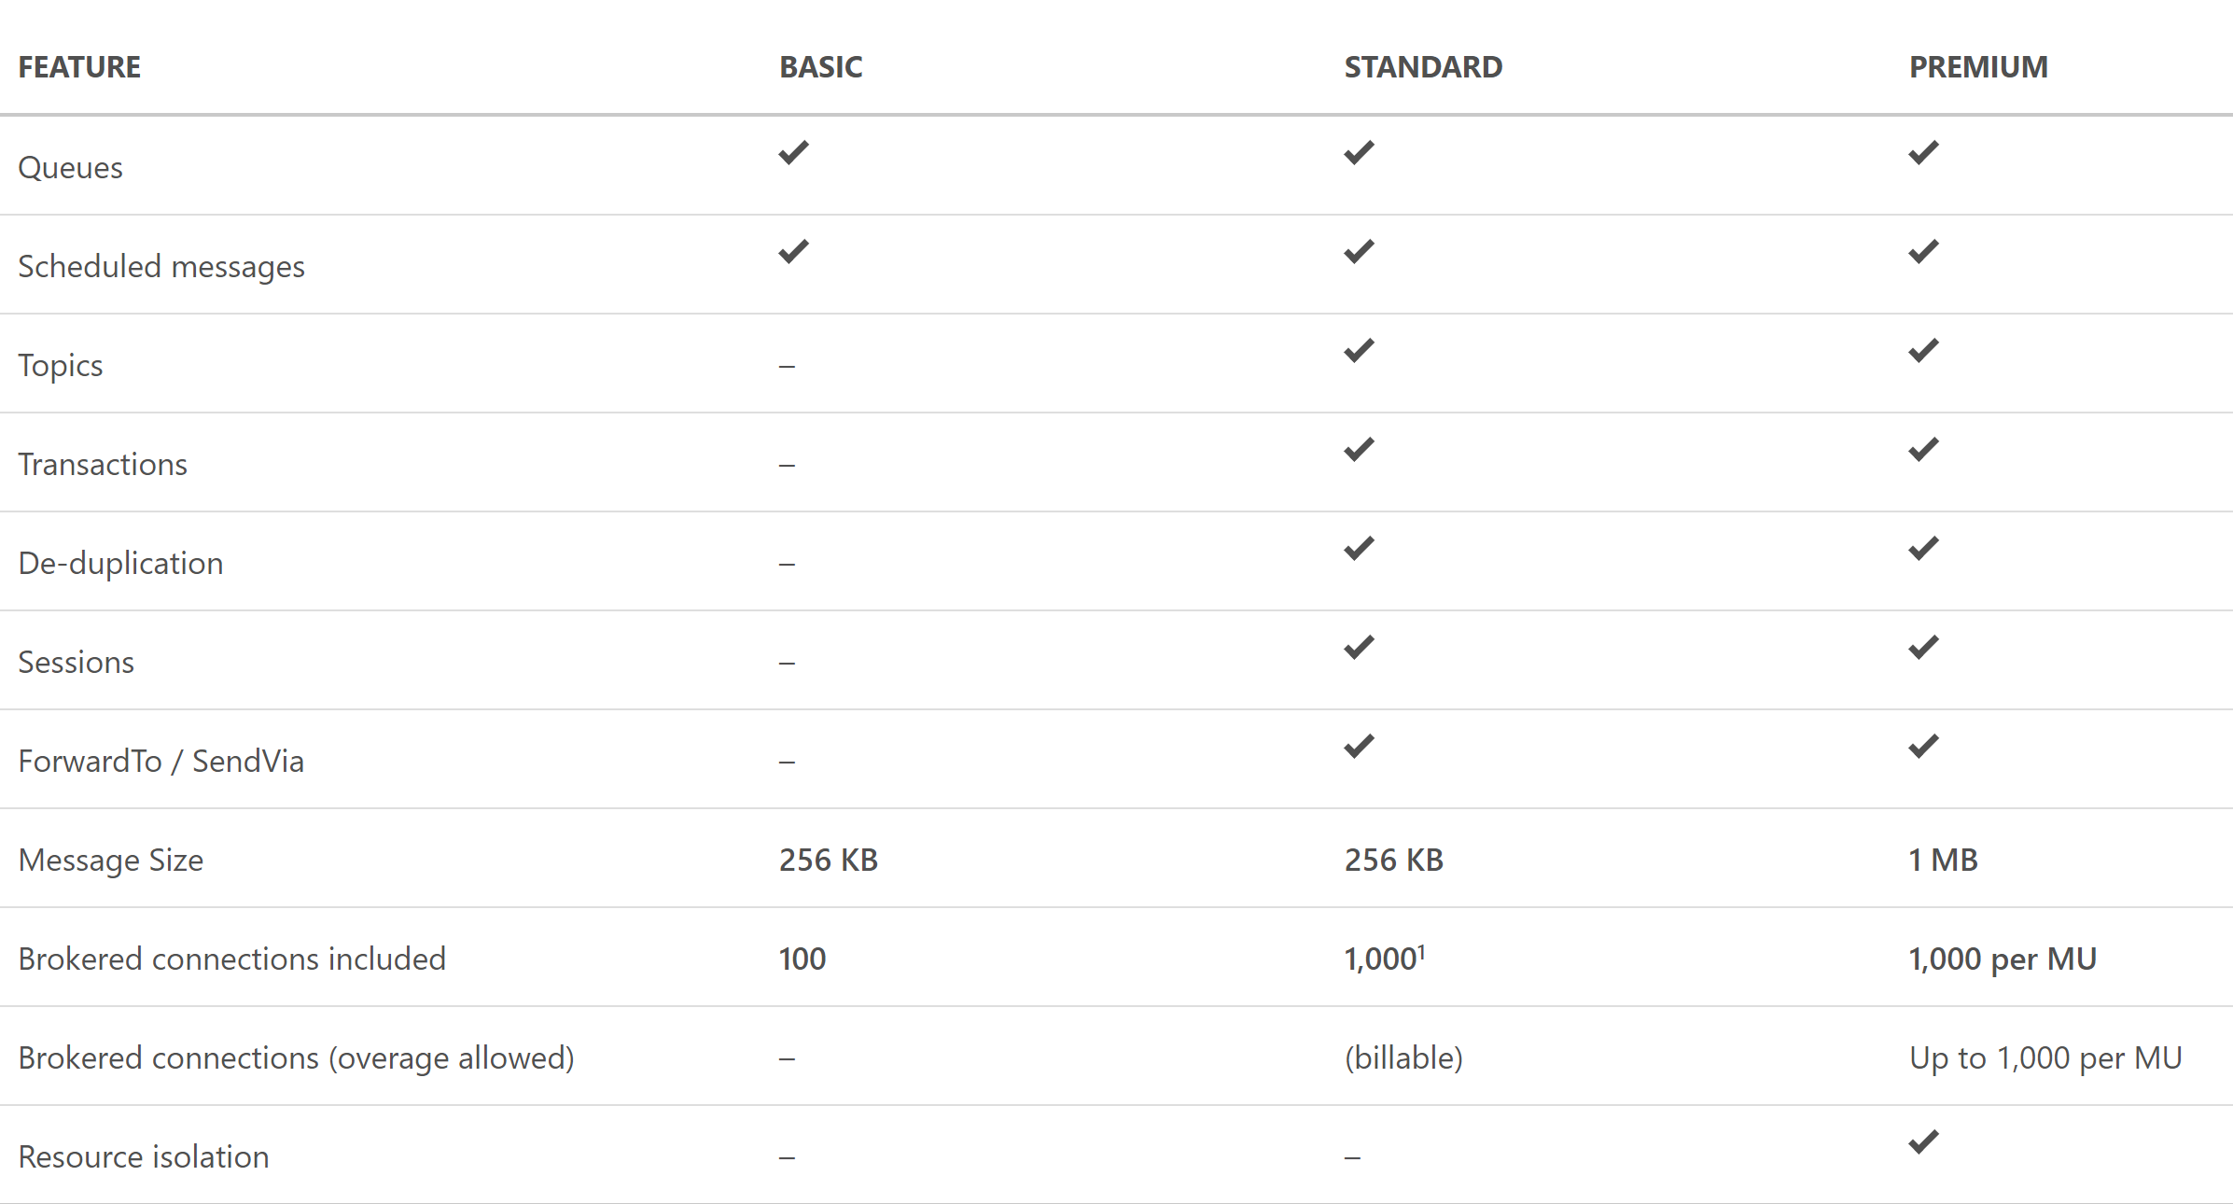
Service Bus Tiers

Slide 27
Question: You need to process IOT data from approx 700 devices. Data is fitered and moved into Blob Storage. Archival of raw ingress data is required for a week. Choose an implementation below.
IOT Hub
SQL Database
Event Hub Standard Tier
Event Hub Basic Tier
IOT Hub
SQL Database
Event Hub Standard Tier
Event Hub Basic Tier

Slide 28
Implement background processing
Azure Web Jobs
Azure Functions

Slide 29
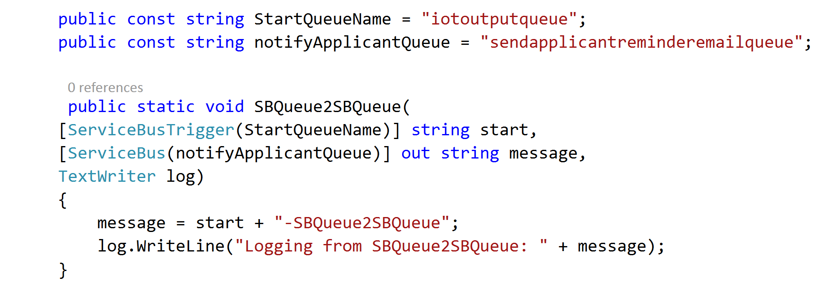
Azure Web Jobs
WebJobs provide an easy way to run scripts or programs as background processes in the context of an App Service, API App or Mobile App
Web jobs can be scheduled , continuous or on-demand
You can upload and run an executable file such as as cmd, bat, exe (.NET), ps1, sh, php, py, js, and jar.
Notes:
USE FUNCTIONS IF YOU WANT TO SCHEDULE TIME

Slide 30
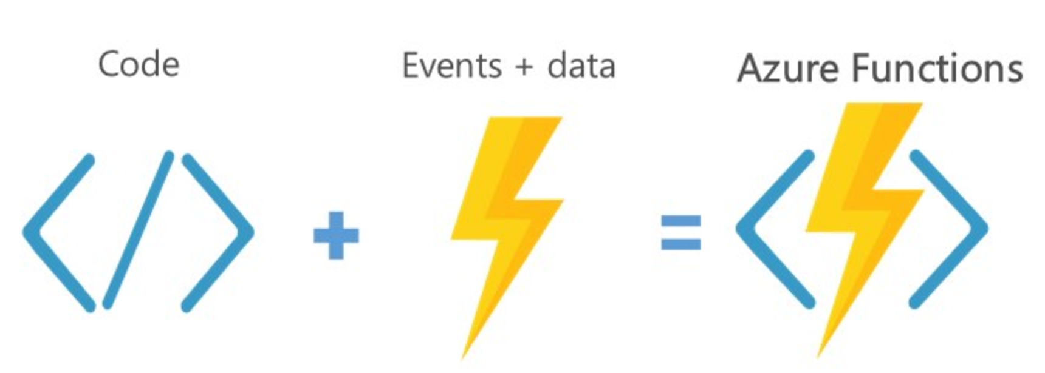
Azure Functions
Server less, highly available and scalable architecture
Supports programming in Node, Javascript, C#, Python and PHP and various CI options.
Suitable for trigger based action.
Web Jobs SDK can be used for local dev and test.
Notes:
Azure Functions can be triggered in many ways, including a pre-defined time by leveraging CRON expressions, by changes in Azure Storage Blob containers, changes to Azure Queues, messages from Service Bus, and HTTP triggers.

Slide 31
Question: You are trying to implement a background process to send emails on a scheduled interval. Which Azure function triggers would be suitable?
Event Hub
Blob Storage
HTTP
Timer
Event Hub
Blob Storage
HTTP
Timer

Slide 32
Integrate Azure Services
Azure Search
Media
Advanced Analytics

Slide 33







Serverless event-driven architecture
Functions
Machine Learning
Relational
API Management
Functions
Service Bus
Logic Apps
3rd Party
Event Grid
Functions
Functions
Cosmos DB
Cognitive Services
Blobs

Slide 34
Design for media service solutions
Notes:
Design for media service solutions
Define solutions using Azure Media Services, video indexer, video API, computer vision API, preview, and other media related services

Slide 35
Design for media service solutions
Encoding
Media Analytics
Streaming
Content Protection
Content Delivery Network (CDN)
Azure Media Player
Notes:
Encoding
Studio grade encoding enables:
Encoding to multiple formats
Scalable batch processing
Thumbnail, overlay, stitching, and clip generation
High-performance encoing
Web, professional, and broadcast workflow support
ISO- and CDSA-certified highly-secure encoding platform
Media Analytics
Extract advanced metadata using deep-learning based analysis to
Automatically generate standard caption files for your videos
Create smooth and stabilized time lapses from first-person videos
Detect motion, faces and emotion
Summarize videos
Moderate content
Streaming
Deliver content to virtually any device at scale
Just-in-time packaging to HLS, MPEG-DASH, and Smooth Streaming
Just-in-time AES encryption and PlayReady DRM technology
Direct integration with CDN
Scalability to handle all audience sizes
Dynamic manifest manipulation for trimming and rendition filtering
Full cloud DVR workflow capabilities
Content Protection
Deliver highly secure content
Secure content from cloud upload to playback
Use AES clear key and multi-DRM (PlayReady, Widevine, and FairPlay Streaming)
Simplify key management and allow dynamic encryption on the fly
Integrate with Active Directory or your own authentication system
Configure protection rules with simple APIs or web portal
Deliver highly-secure playback with native HTML5 or client SDKs for all device
CDN
Secure and reliable global content delivery and acceleration
Global coverage and massive scalability
Integrated into your Azure services, letting you scale in minutes
Simple setup and no commitment: pay-as-you-go
Azure Media Player
A single player for your content on multiple devices
Supports most popular screens and devices
Automatically chooses the best playback format
Easily integrates into web and app solutions
Lets you use familiar JavaScript API development
Includes automatic fallback for Flash and Silverlight
Gives you integrated content protection

Slide 36
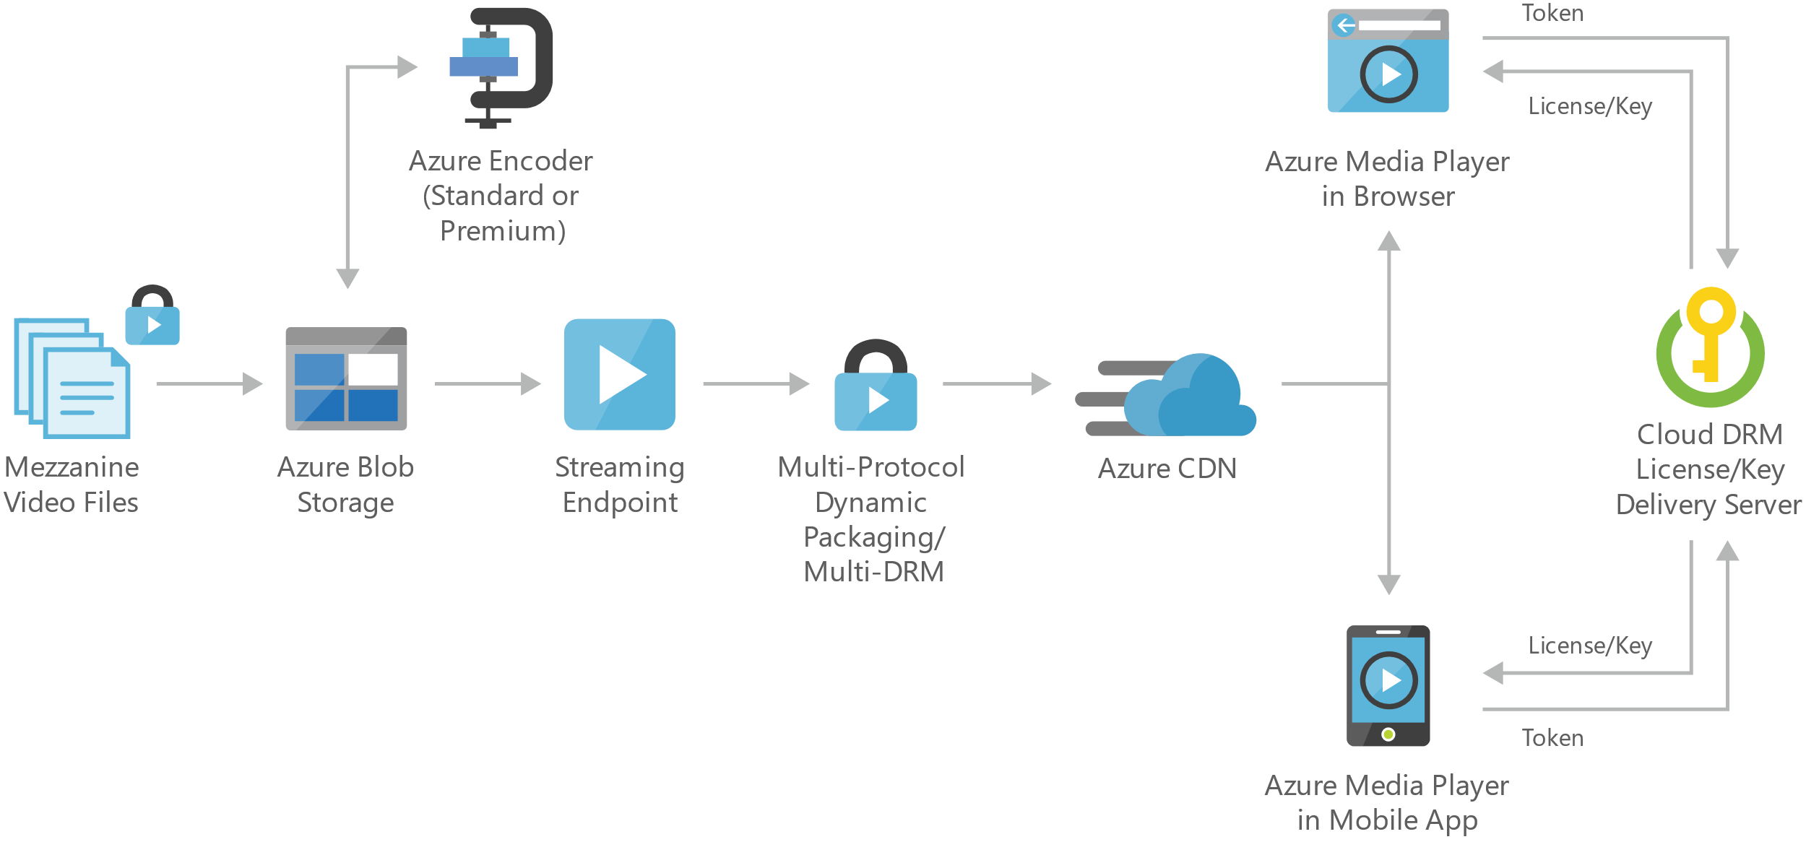
Video-on-demand digital media

Slide 37
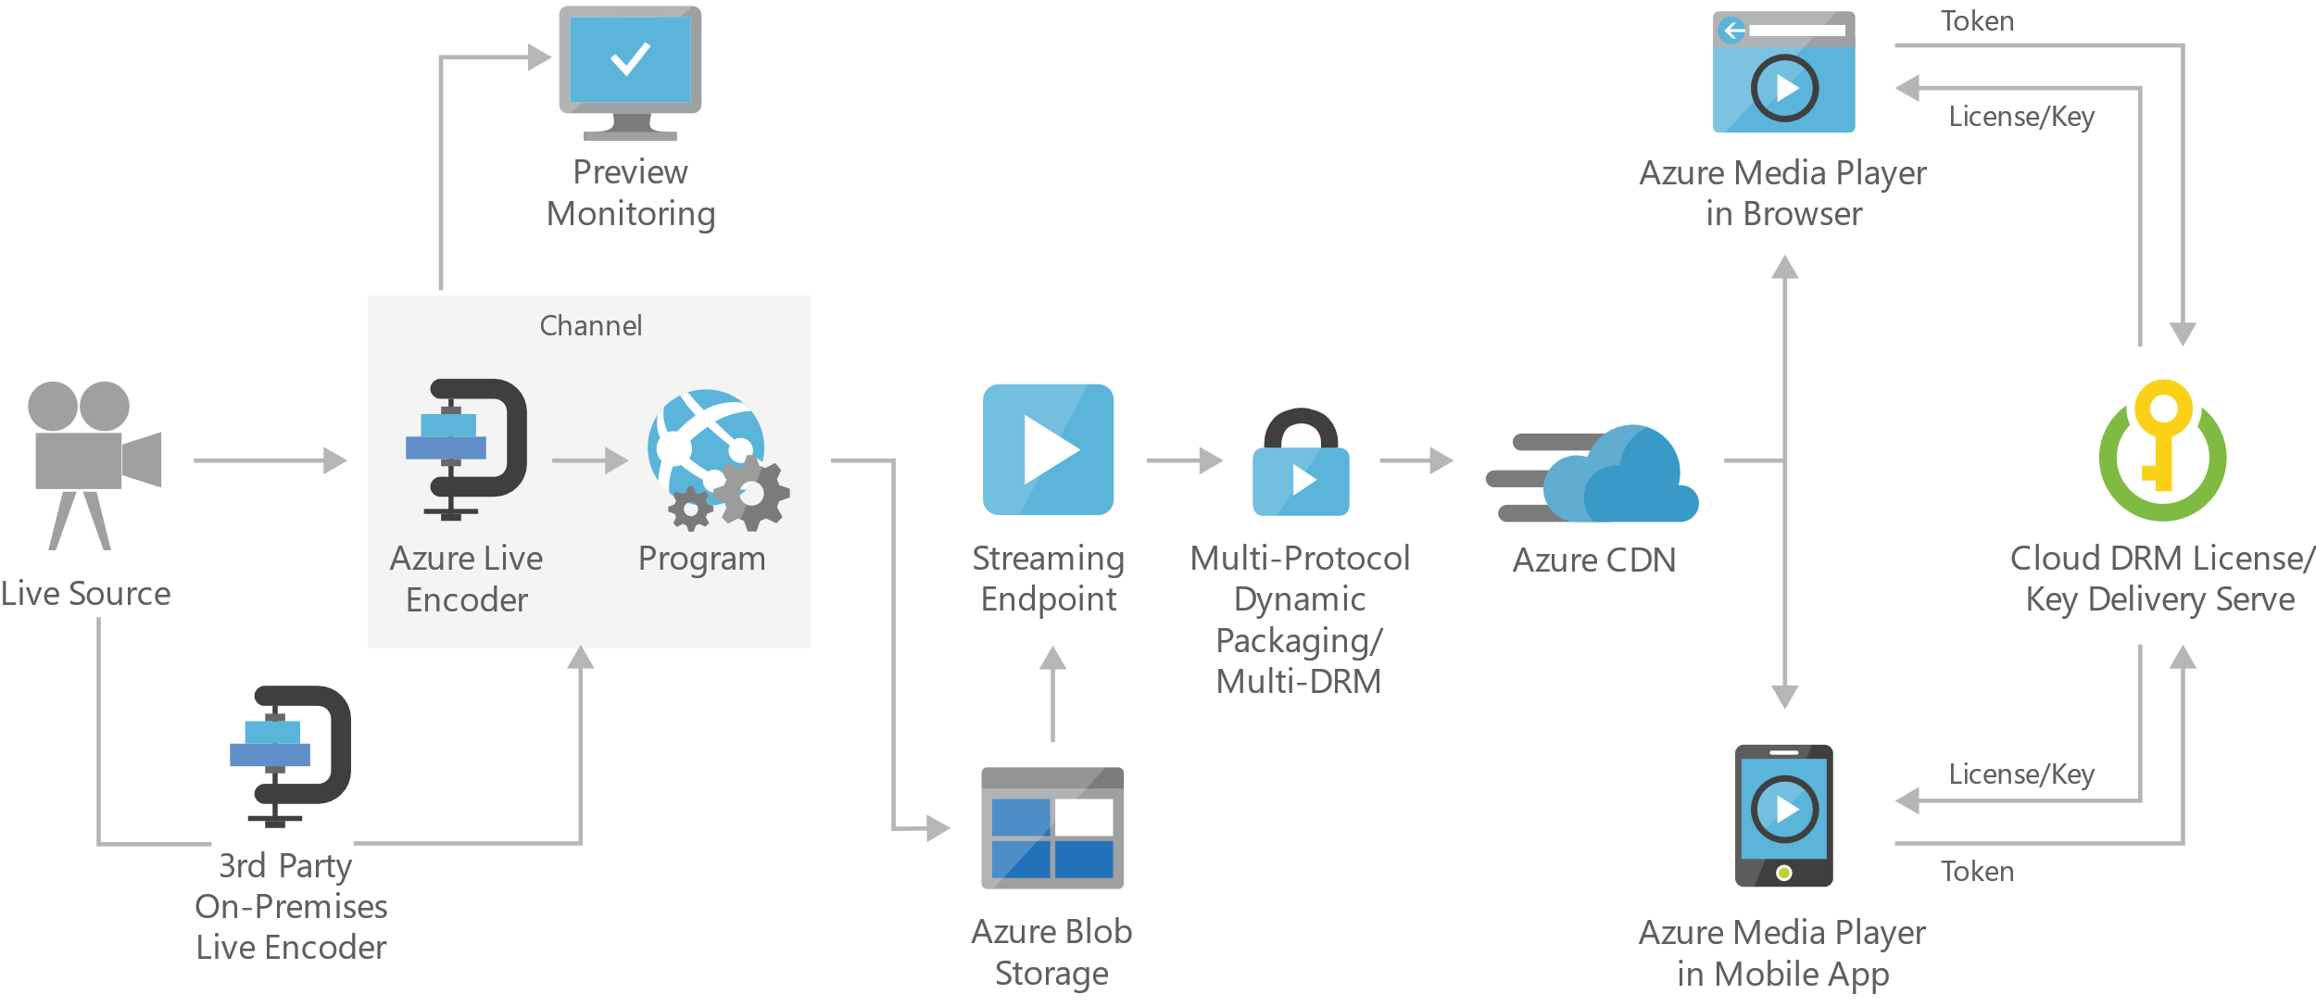
Live streaming digital media
Notes:
On-premises live encoder - Outputs the live source for ingest into the cloud as RTMP, MPEG-Transport Stream, or fragmented mp4 formats.
Preview monitoring - Provides the ability to preview and validate a live stream before further processing and delivery.
Streaming endpoint - Represents a streaming service that can deliver content directly to a client player application, or to a content delivery network (CDN) for further distribution.
Multi-DRM - Delivers content securely using multi-DRM (PlayReady, Widevine, FairPlay Streaming) or AES clear key encryption.

Slide 38
Azure Search Overview
1 of 4
A fully-managed search solution that allows developers to enable search experiences in applications.
Embed a sophisticated search experience into web and mobile applications without having to worry about the complexities of full-text search and without having to deploy, maintain or manage any infrastructure.
Perfect for enterprise cloud developers, cloud software vendors, cloud architects who need a fully-managed search solution.
Surface Your Data
Reduce Complexity
Move Quickly with Confidence
Powerful, guaranteed performance
Sophisticated search
Connects business goals to the application
Simplify search index management
Scale-out easily
Fast time to market
Backed by Microsoft Azure
Notes:
LIKE
OR WHERE LIKE
OR WHERE LIKE
FACETED SEARCH

Slide 39
Azure Search
Use Cases
Ecommerce - Searching for products
News Feed – Newer articles are more relevant
Geospatial search – A Search that is aware of your location.
Unstructured content – Index and search documents
Some Features
Term Boosting – Quiet clean hotel
Synonyms – Motel, Hotel
Notes:
HOTEL SEARCH—INCLUDE MOTEL SEARCH BUT DEPRECATE THOSE RESULTS
EXAM: BE AWARE OF INDEX TIERS

Slide 40
What you can do with Media Services
Live and on-demand streaming
Digital marketing platforms
Enterprise video management
Reach hundreds of millions of device endpoints.
Services and tools for video preparation, management and publishing.
Distribute and manage corporate communications, IT, HR content and training.
Notes:
EXAM: DEDICATED STORAGE FOR MEDIA SERVICES

Slide 41
Question: Your company uses Azure media services to supply advertising media to partners. Multiple channels are configured within a single instance of Media services. You need to enforce a rule that only content that contains a signed security token can be uploaded. How can we enforce this rule ?
Use a Network Security Group
Create an ingest restriction
Use an Access Control List
Set media services authorization policy to Token
Use a Network Security Group
Create an ingest restriction
Use an Access Control List
Set media services authorization policy to Token

Slide 42



Advanced Analytics
Event production
Collection
Ingestion
Stream Analytics
Storage and
Batch Analysis
Presentation and action
Event Hubs
Event Hubs
Service Bus Queues, Topics
Web/thick client dashboards
Applications
Devices
Stream Analytics
SQL DB, DW
IOT hubs
Legacy IOT (custom protocols)
Search and query
Storage Blobs and Tables
Cloud gateways (web APIs)
Blobs
Document DB
IP-capable devices (Windows/Linux)
Data analytics (Power BI)
Machine
Learning
Azure Data Lake
Low-power devices (RTOS)
Field gateways
Power BI
Devices to take action
Reference Data
more to come…

